Slide 1
Constrained motion on surfaces
Computational Physics I - PHYCS425
Authors:
Ali Mirza Isa 20186917
Asif Bin Ayub 20191251
Kumail Abdulaziz 20196080

Slide 2
Contents of this presentation
Introduction
Theory
1
2
Part I
Part II
3
4
Constrained motion
Runge-Kutta method (RK4)
Constrained motion in 1D
Constrained motion in 2D

Slide 3
1
Introduction
Constrained motion

Slide 4
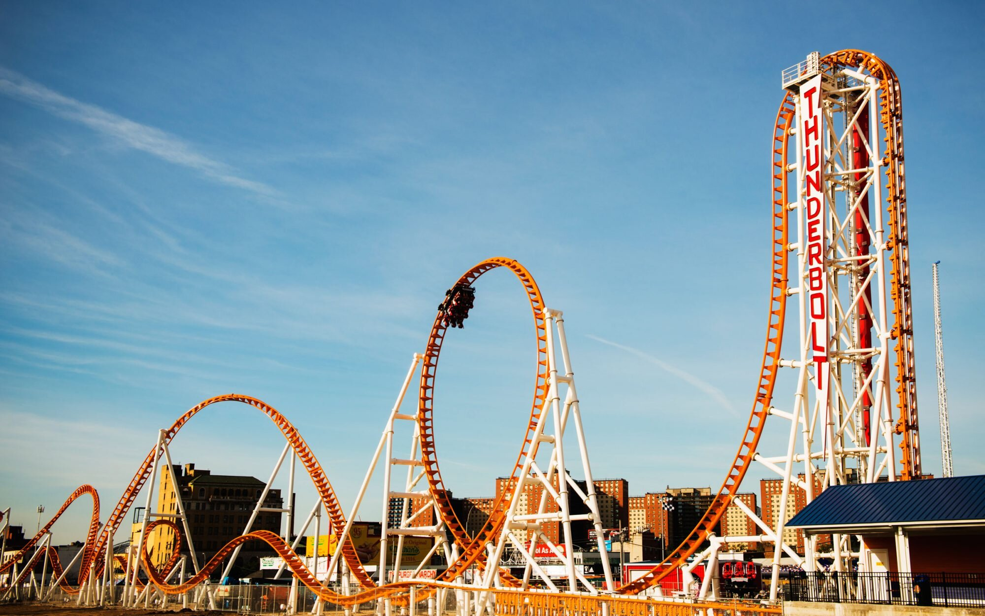
Where can you see constrained motion?
Constrained motion is everywhere!
If you ever rode on a roller coaster, or tried ice skating, you know how frightening it can be. One way to overcome this fear is by studying constrained motion in more detail.

Slide 5
2
Theory
Runge-Kutta method (RK4)

Slide 6
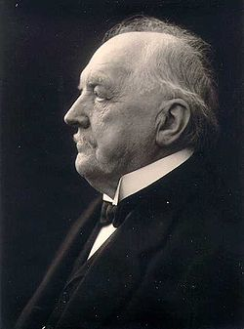
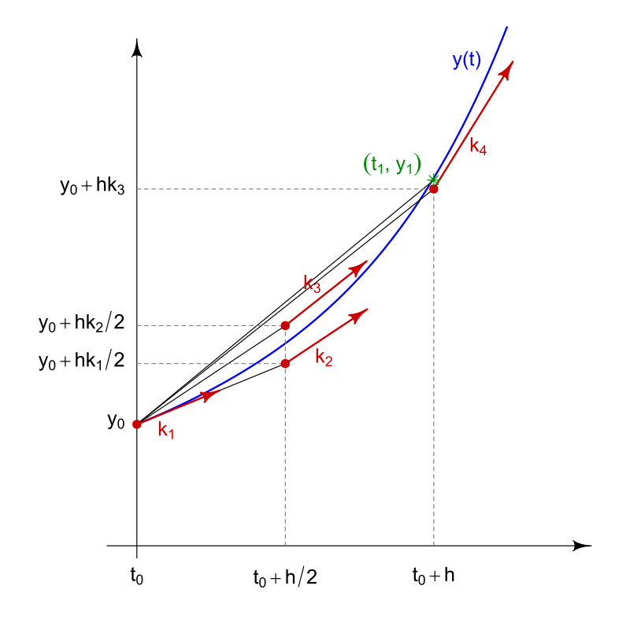
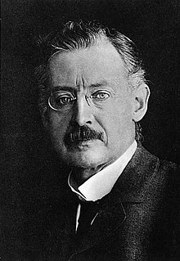

Runge-Kutta method (RK4)
A family of numerical methods developed by Carl Runge & Wilhelm Kutta around 1900.
RK4 scheme is an explicit method that has a truncation error of $O\left(h^{5}\right)$, very accurate for simulations.
Preserves time reversal symmetry, leading to more accurate simulation of physical systems.

Slide 7
3
Part I
Constrained motion in 1D

Slide 8
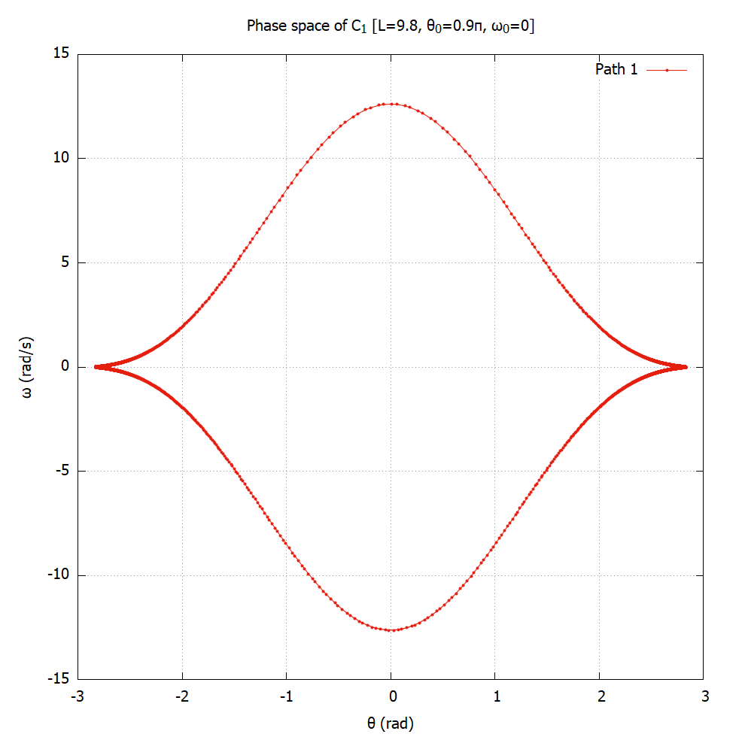
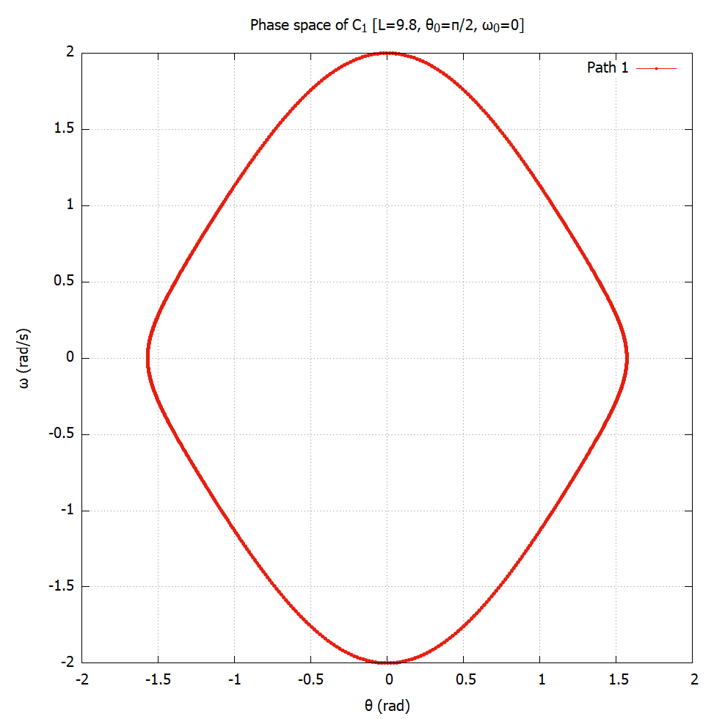


Curve $C_{1}$
Oscillatory motion and equilibrium points
The motion of $C_{1}$ is oscillatory for all initial conditions allowed by the system.
The phase portraits form a closed shape, indicating periodic motion.
Equilibrium point is at: $\left(0,−\frac{ℓ}{2}\right)$ or $θ=0$

Slide 9
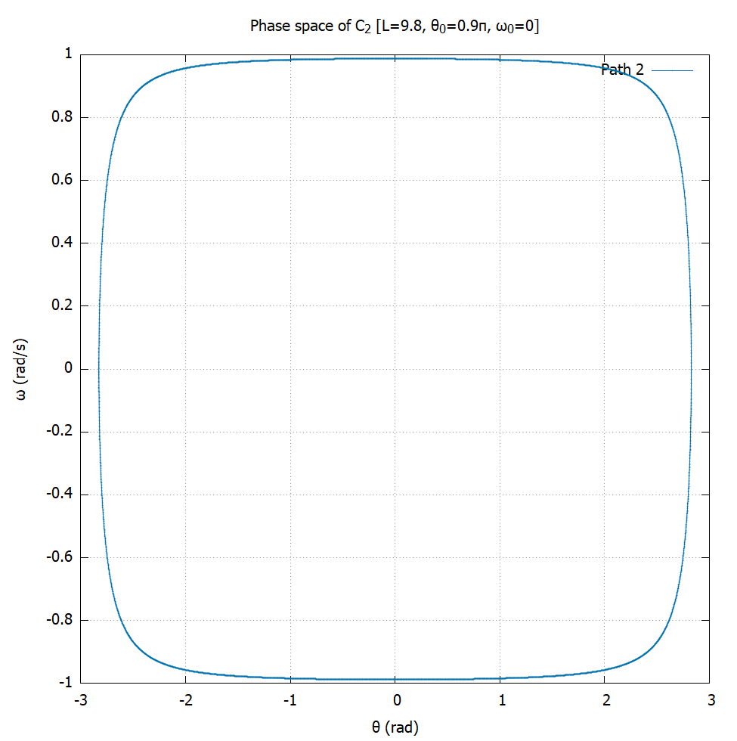
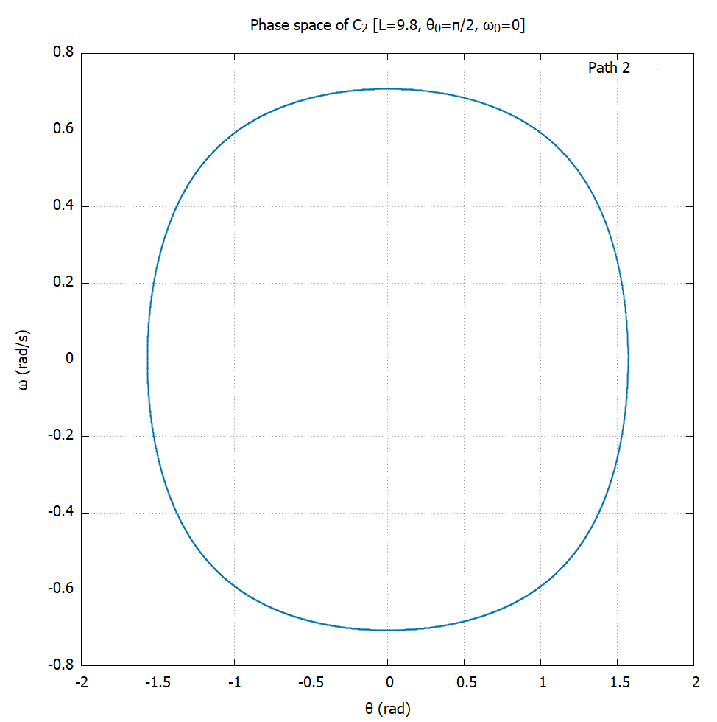


Curve $C_{2}$
Oscillatory motion and equilibrium points
Curve $C_{2}$ exhibits oscillatory motion, but not for all initial conditions.
If the initial velocity is too high, the particle can escape the curve.
Equilibrium point at: $\left(0,0\right)$ or $θ=0$

Slide 10

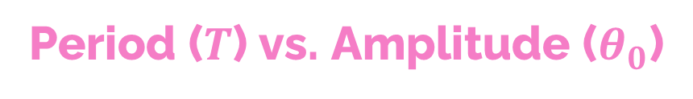
Period ($T$) vs. Amplitude ($θ_{0}$)
The period remains constant for $C_{2}$, but increases with $θ_{0}$ for $C_{1}$

Slide 11
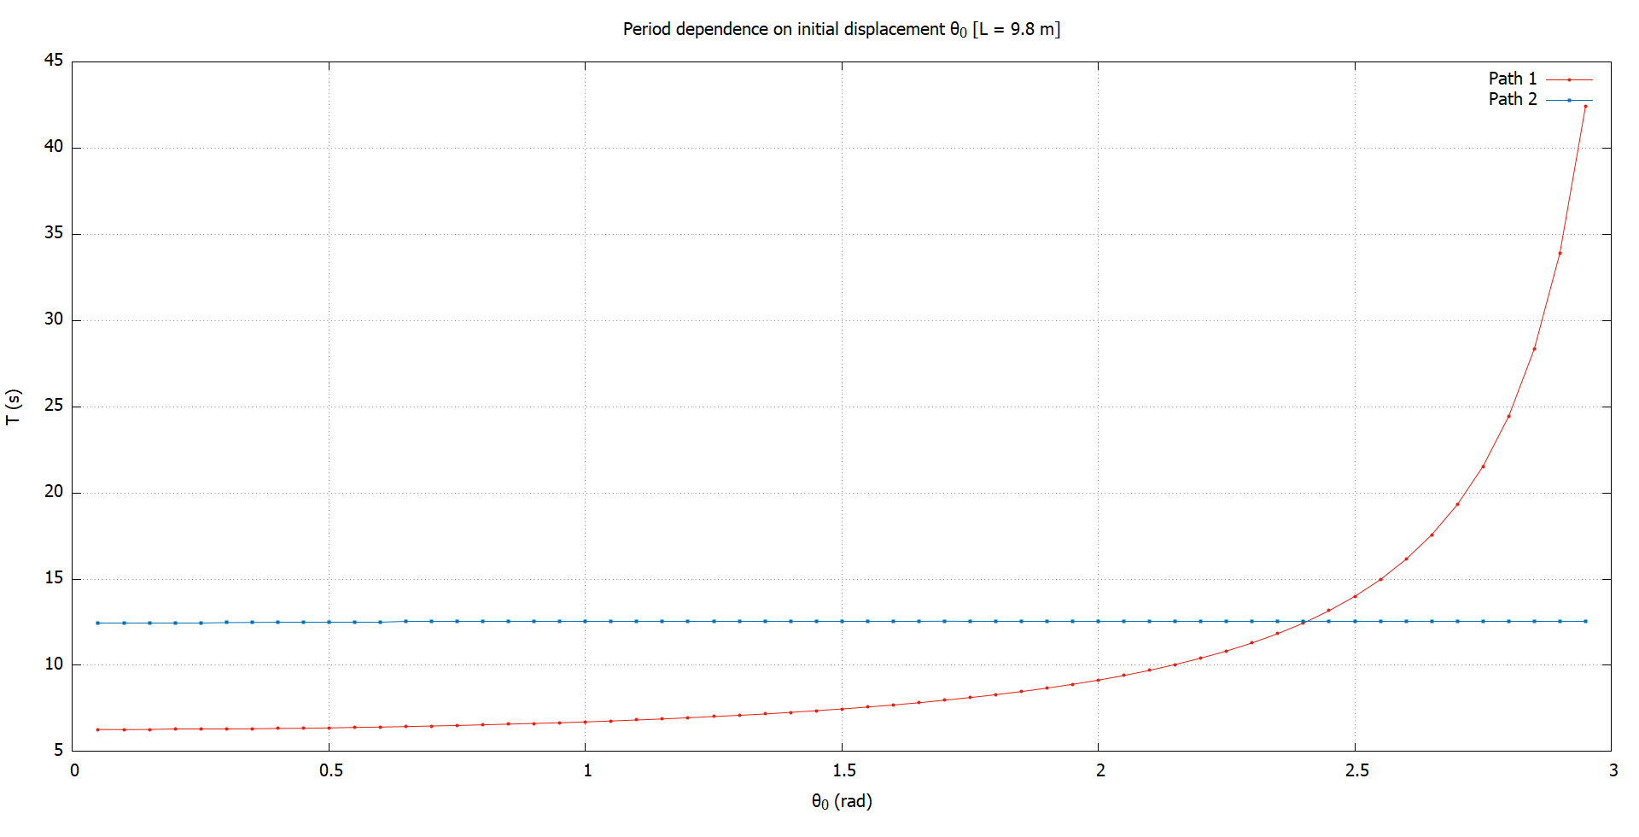


$$T(θ_{0},ℓ=g)$$
Period ($T$) vs. Amplitude ($θ_{0}$)
$$T_{1}≈\frac{2π}{\sqrt{1−\sin^{4}{\frac{θ_{0}}{2}}}}$$
$$T_{2}=4π$$

Slide 12
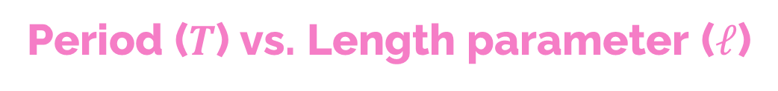

Period ($T$) vs. Length parameter ($ℓ$)
The period increases for both curves as we increase $ℓ$

Slide 13
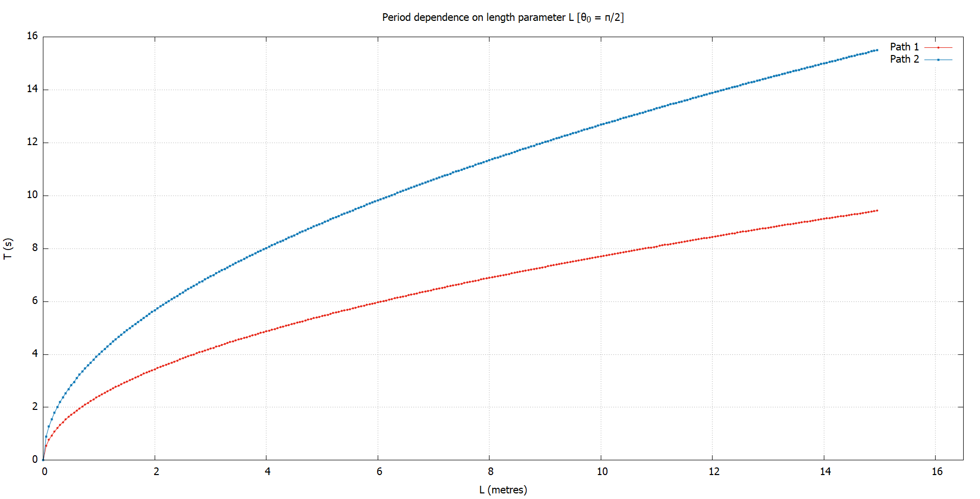


$$T\left(θ_{0}=\frac{π}{2},ℓ\right)$$
Period ($T$) vs. Length parameter ($ℓ$)
When we try to fit these curves, we find:
$$T_{1}∝\sqrt{ℓ}$$
$$T_{2}∝\sqrt{ℓ}$$

Slide 14





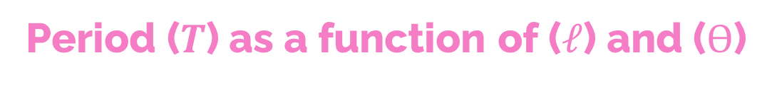

$$T(θ_{0},ℓ)$$
Period ($T$) as a function of ($ℓ$) and ($Ѳ$)
$$T_{1}≈\frac{2π}{\sqrt{1−\sin^{4}{\frac{θ_{0}}{2}}}}$$
The expression for $C_{2}$ is quite accurate, and we think is exact.
$T_{1}$ is less accurate, giving a 3.36% error when compared to our data set.
Curve $C_{1}$
Curve $C_{2}$
$$T_{2}=4π\sqrt{\frac{ℓ}{g}}$$

Slide 15
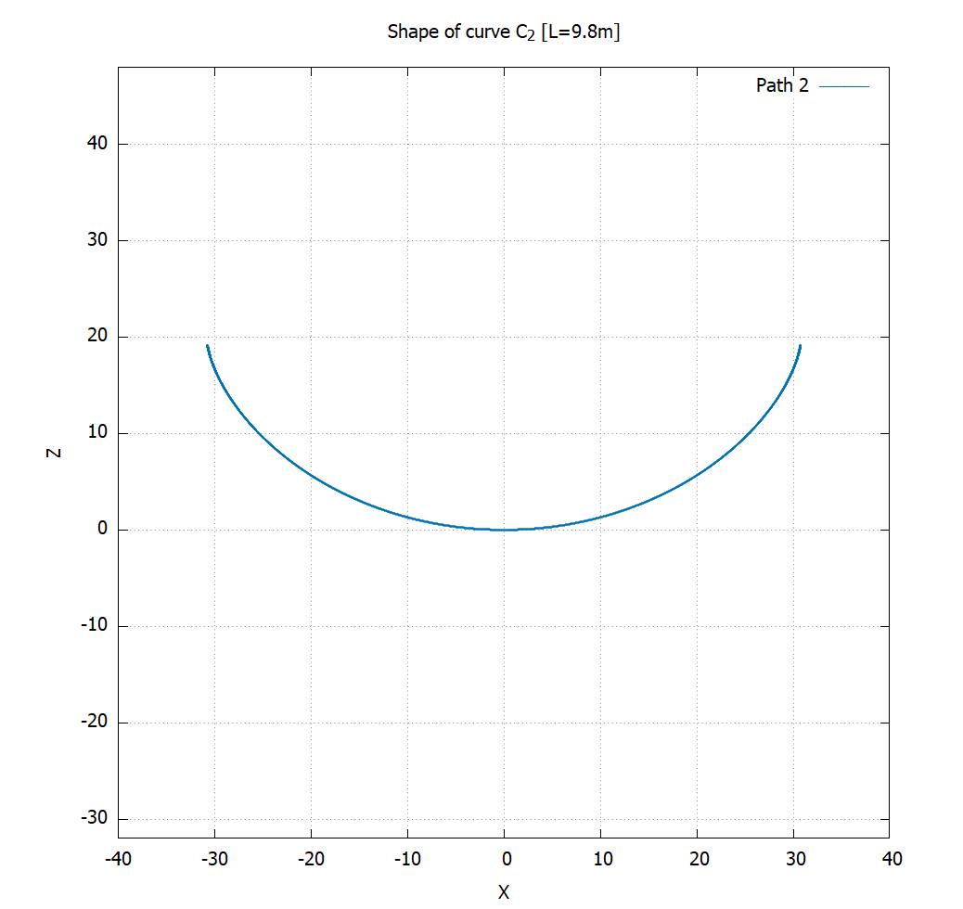
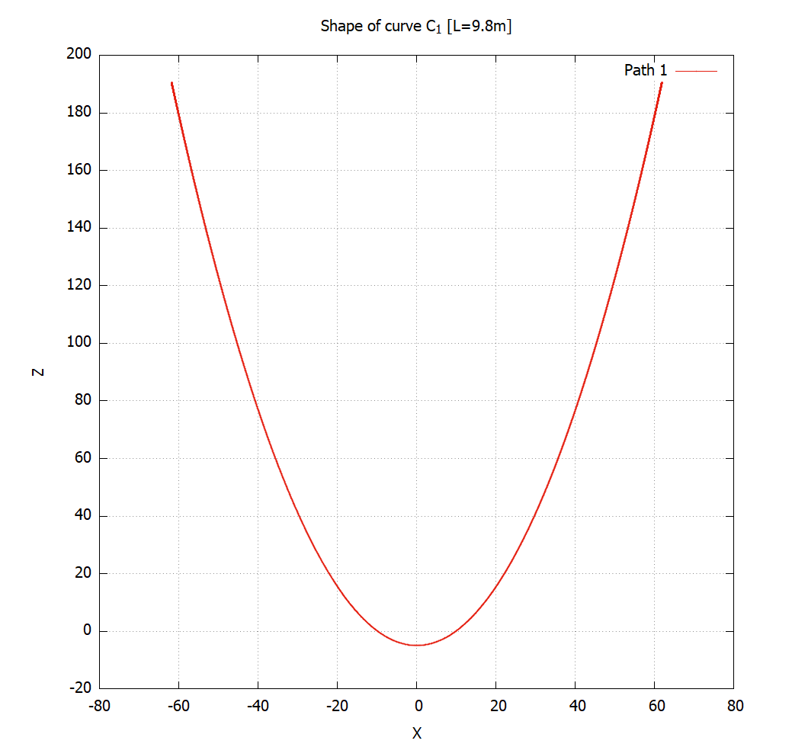

Identifying paths
$C_{2}$ is a cycloid. This was hinted at from our period analysis. Also, we derived the EoM.

Slide 16
Identifying paths

Slide 17
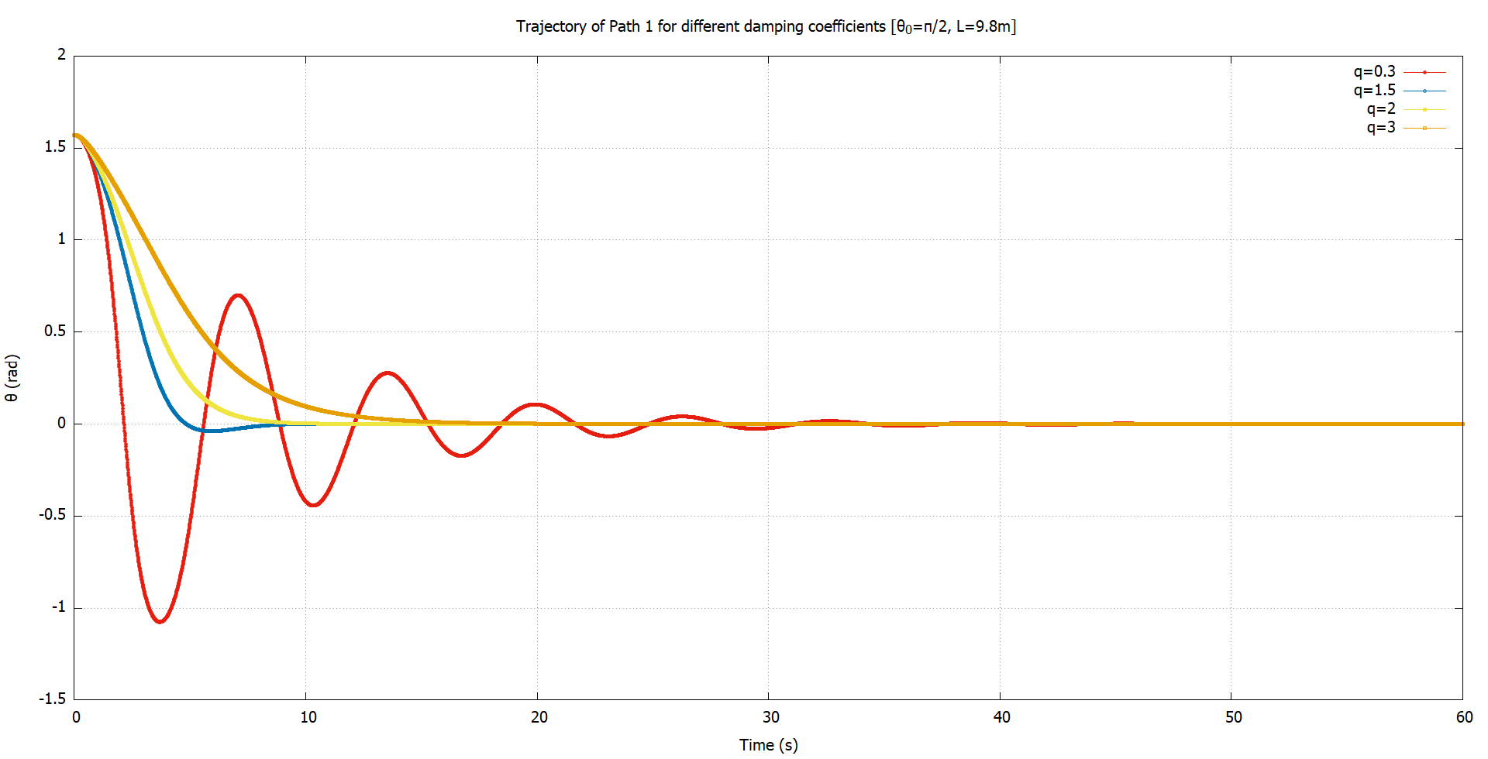


Damping ($C_{1}$)
Adding Damping & Driving Forces
A linear damping force was added: $F=−q\dot{θ}$
We observed underdamped, overdamped & critically damped motion.

Slide 18

Damping ($C_{1}$)

Slide 19
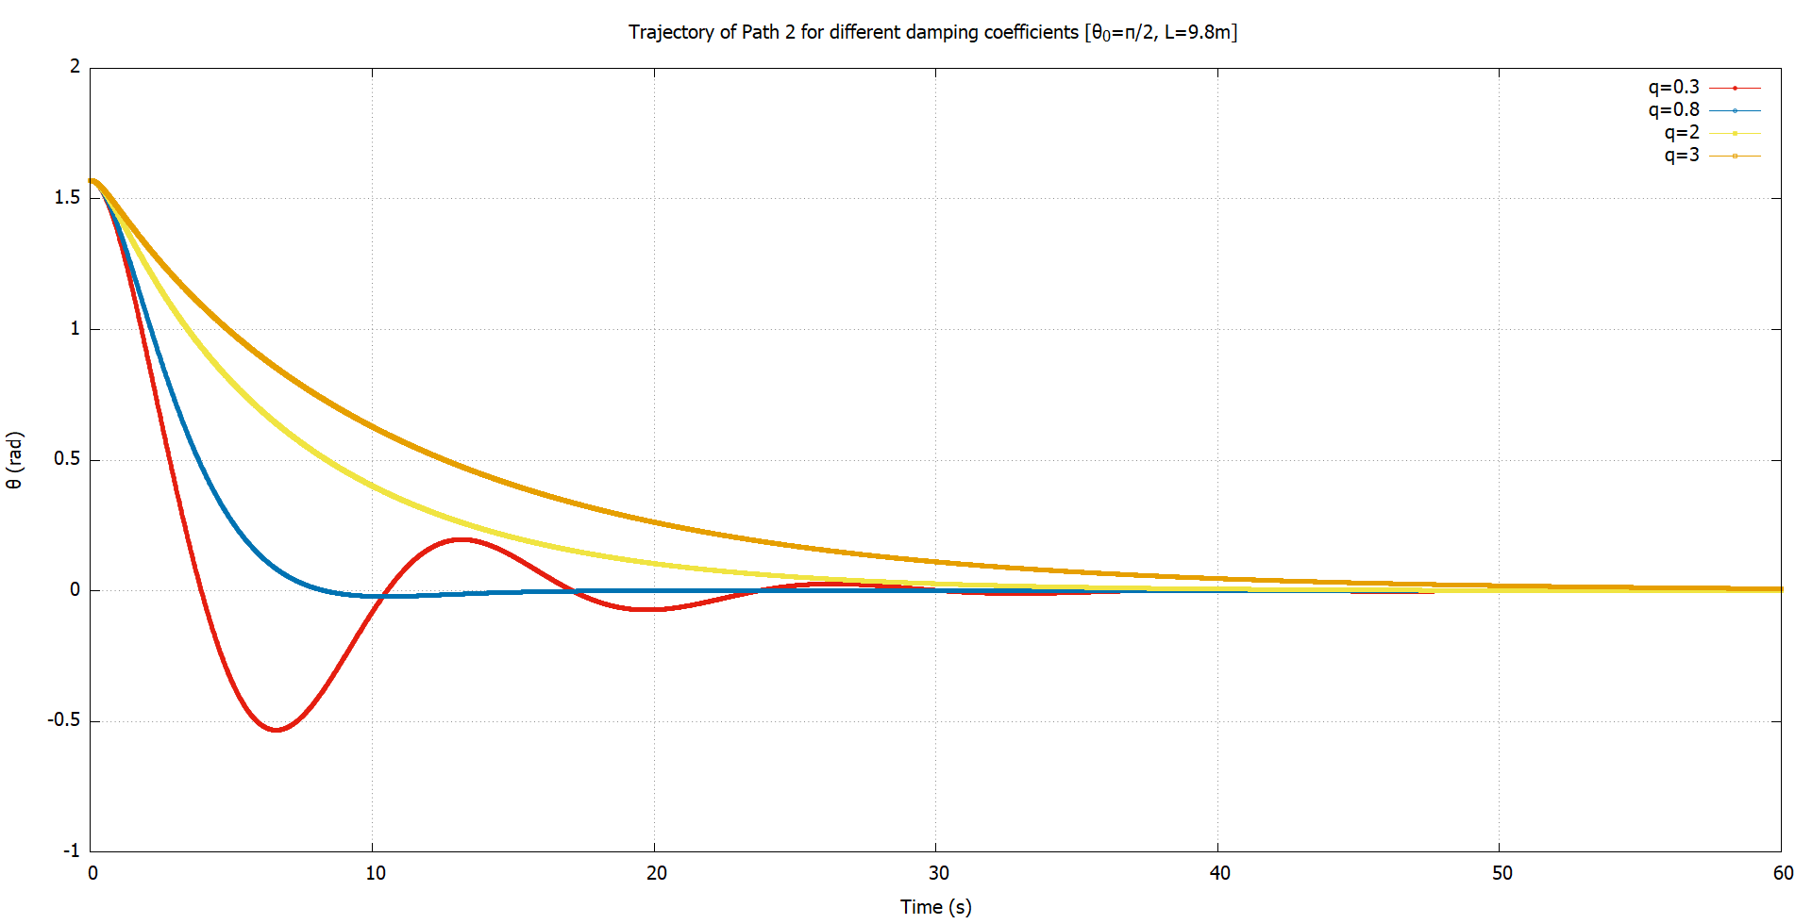


Damping ($C_{2}$)
Adding Damping & Driving Forces
The same results were obtained for $C_{2}$

Slide 20

Damping ($C_{2}$)

Slide 21
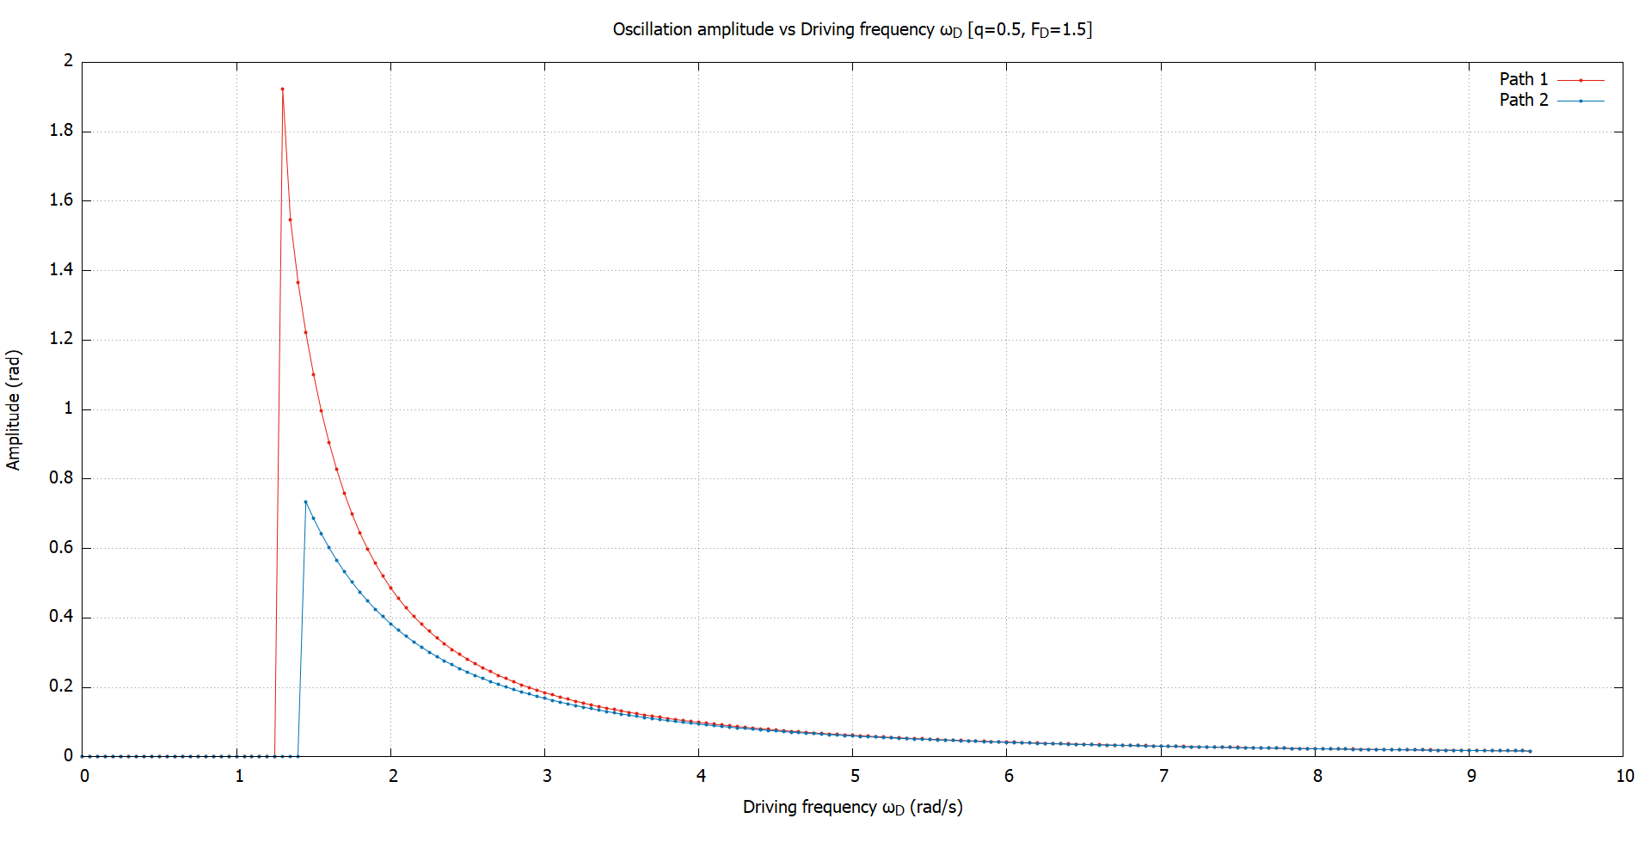

Driving frequency
(Where is) Chaos
The amplitude decreases with increasing $ω_{D}$.
At low frequencies, both curves blow up.
There is a resonance like behavior.

Slide 22

(Where is) Chaos
At low $ω_{D}$, both curves blow up.

Slide 23
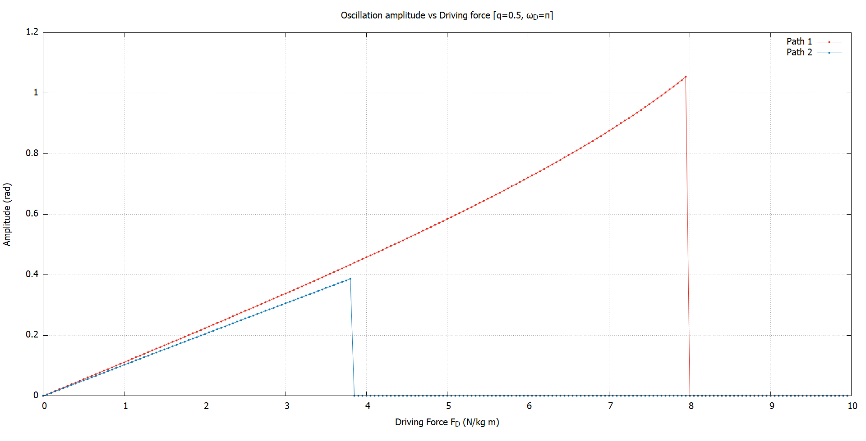

Driving Amplitude
(Where is) Chaos
As we increase $F_{D}$, the oscillation amplitude increases.
But it blows up if $F_{D}$ is very large.

Slide 24

(Where is) Chaos
Increasing $F_{D}$ causes both curves to blow up

Slide 25

So, is there any chaos?
Some “period multiplied” trajectories were found for $C_{1}$, but not for the same $ω_{D}$.
As far as we know, there is no chaos, at least not through the period doubling route.
Needs more rigorous investigation using Lyapunov exponents.

Slide 26
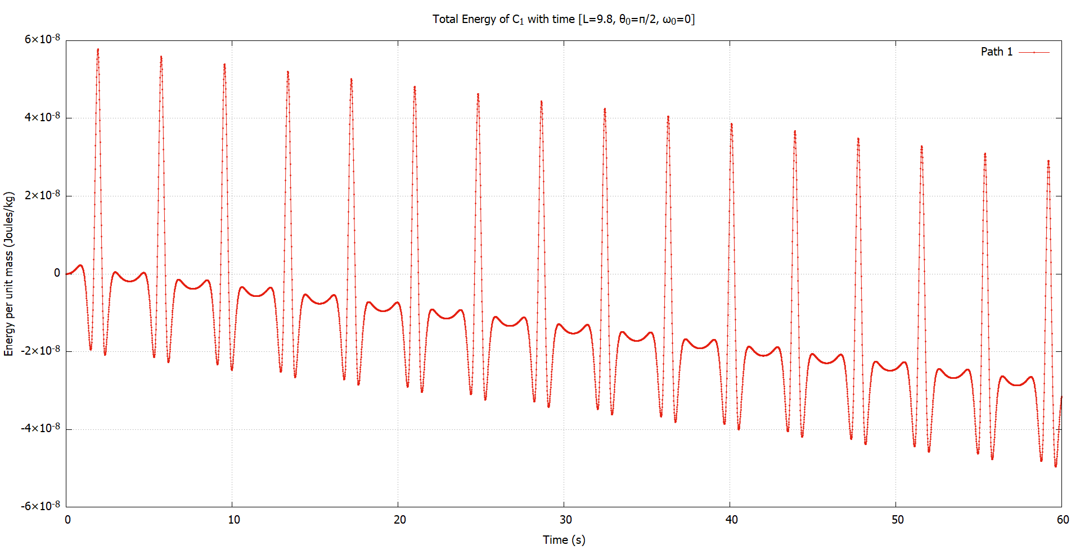

Curve $C_{1}$
Conservation of energy
For undamped, undriven system, the energy is almost constant.
So, energy is indeed conserved.

Slide 27
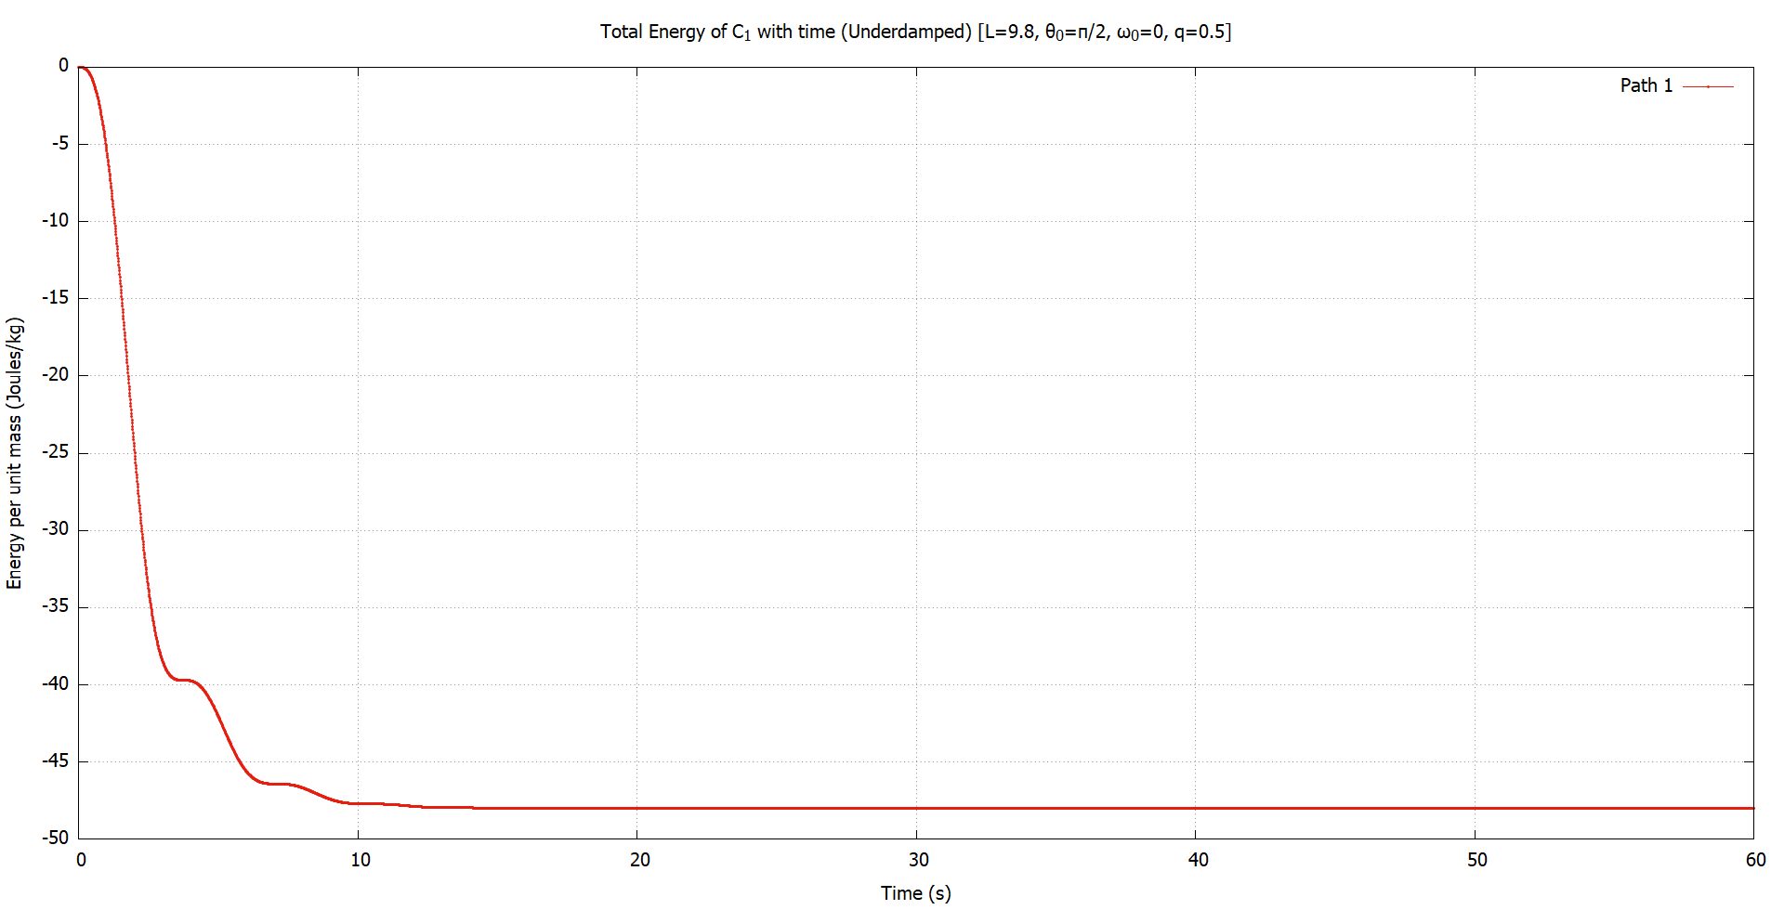

Damped ($C_{1}$)
Conservation of energy
When we add a slight damping force, the energy is quickly dissipated, which is the expected behavior.
Energy is negative because the equilibrium height is below 0.

Slide 28
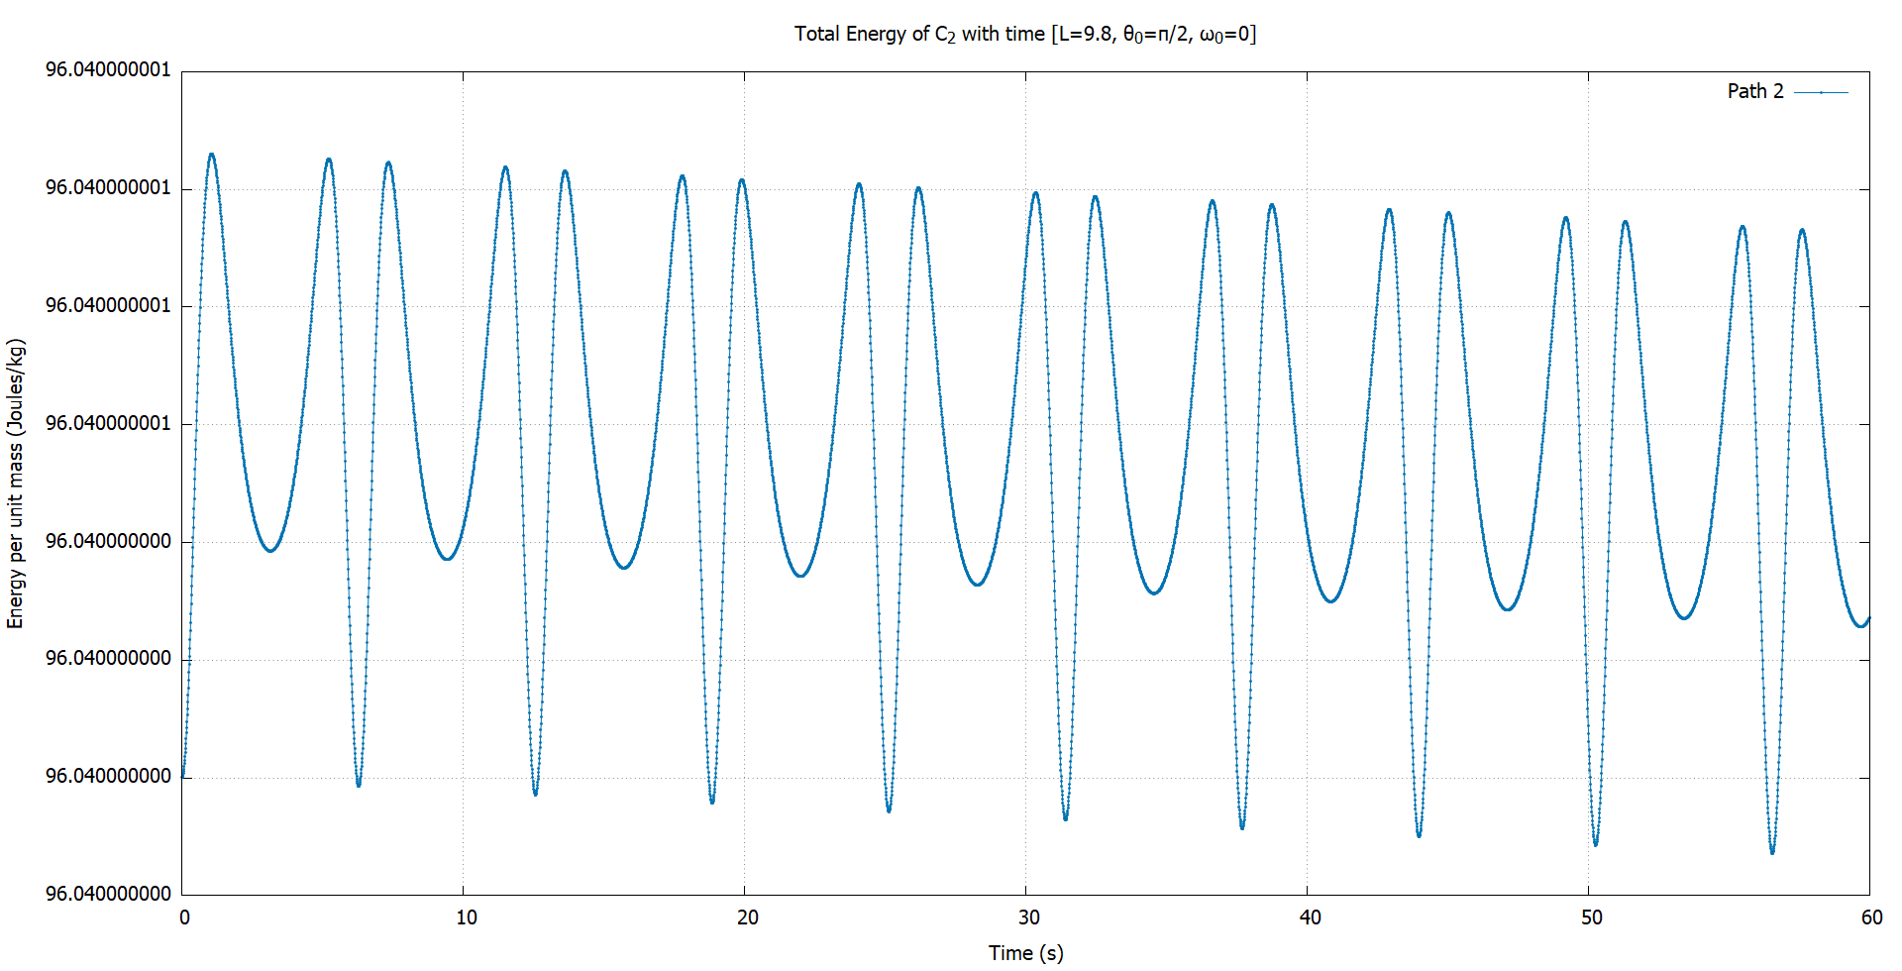


Curve $C_{2}$
Conservation of energy
In the absence of damping, energy is conserved for $C_{2}$ as well. The variation is very small and negligible.

Slide 29
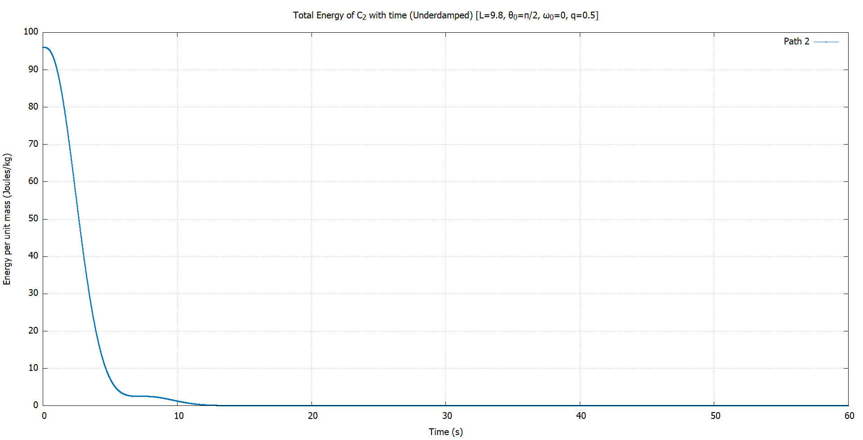


Damped ($C_{2}$)
Conservation of energy
Similar to $C_{1}$, the energy is quickly dissipated, reaching 0, corresponding to the equilibrium point.

Slide 30
4
Part II
Constrained motion in 2D

Slide 31
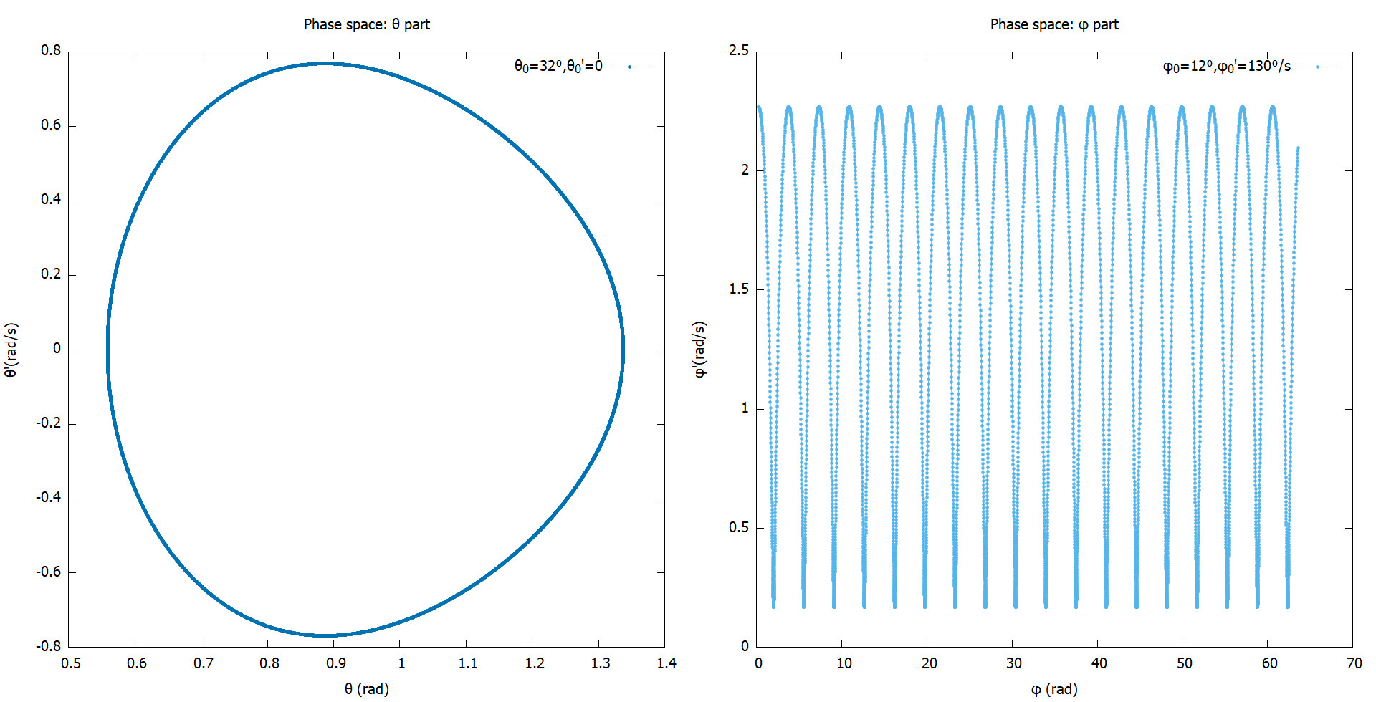

Phase space
Oscillatory motion
Motion in $θ$ is oscillatory. Along φ, it is periodic, but is not restricted to $[0,2π]$
The system blows up if initial angular velocities are too high.
Odd behavior when $θ>90⁰$

Slide 32
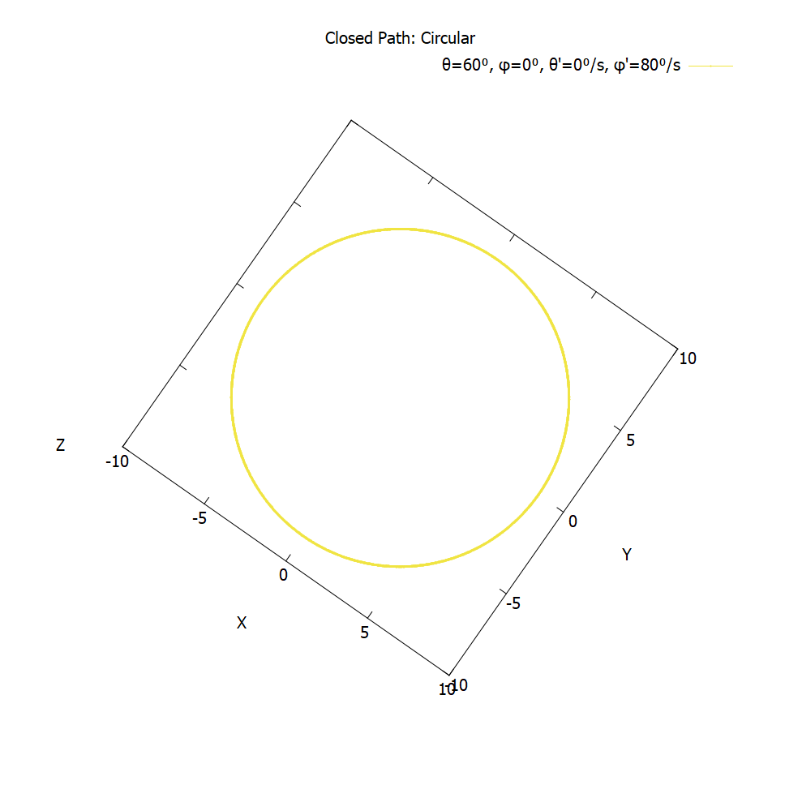
Closed paths
These are closed circular paths.

Slide 33
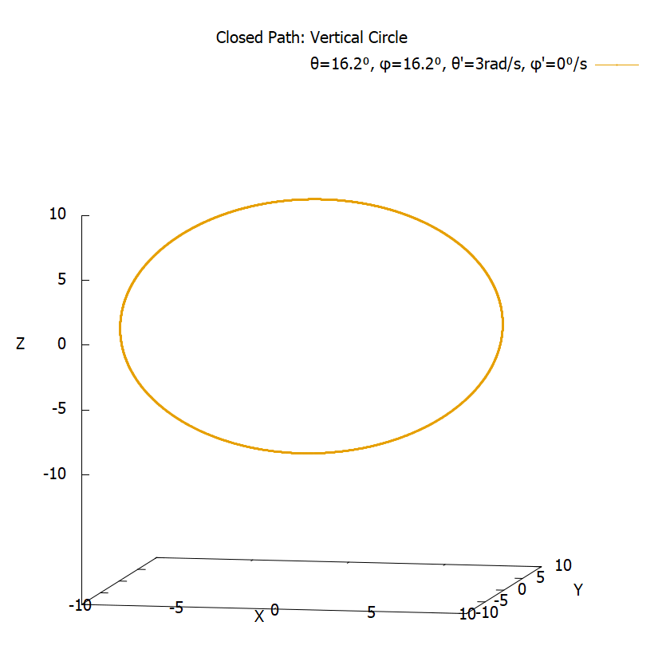
Closed paths
These paths also show that simple pendulum motion can be recreated on spherical surface.

Slide 34
Closed paths
We obtained “Lissajous-like” paths that are closed. Not trivial to find.

Slide 35
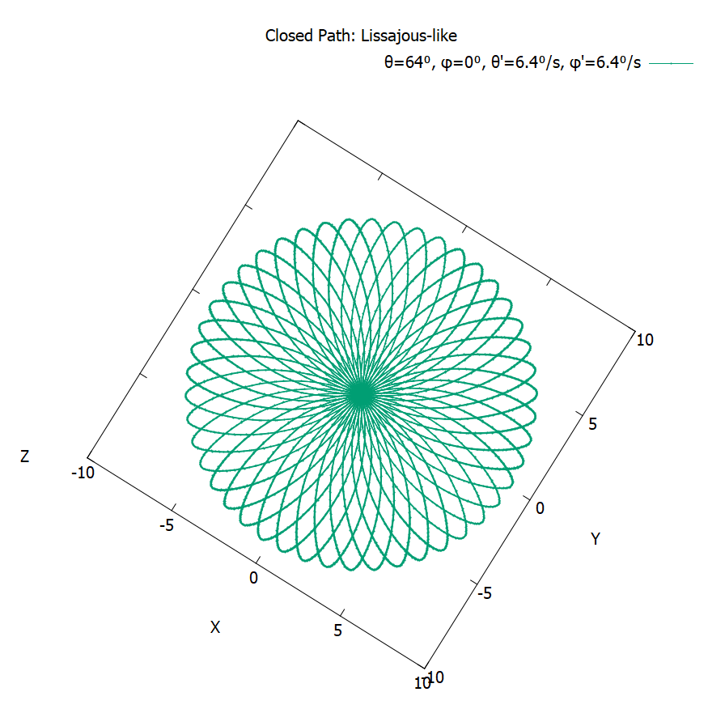
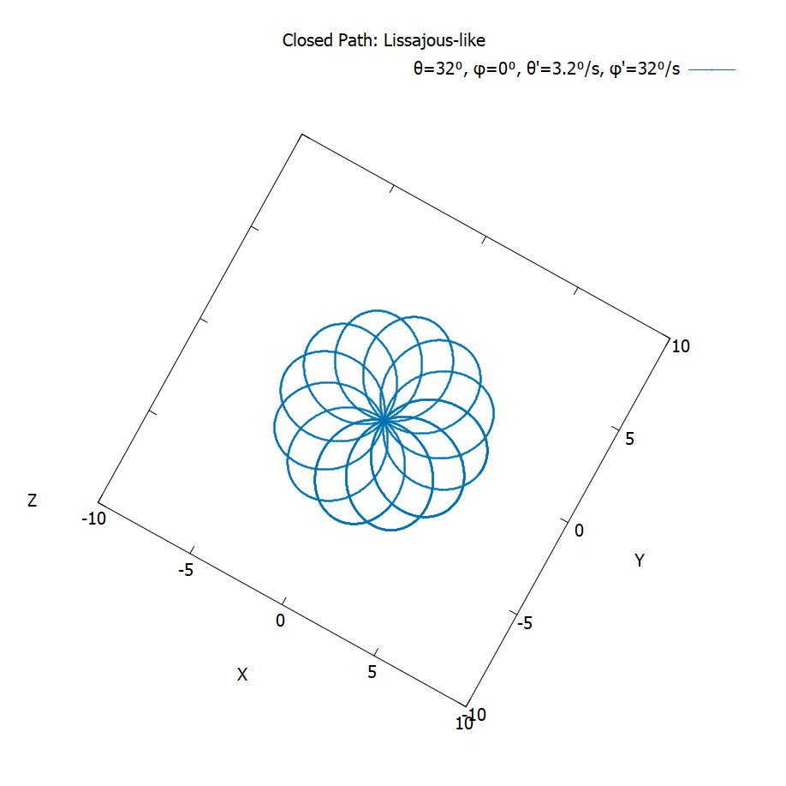
Closed paths
Here are some more of them. Pretty, aren’t they?

Slide 36
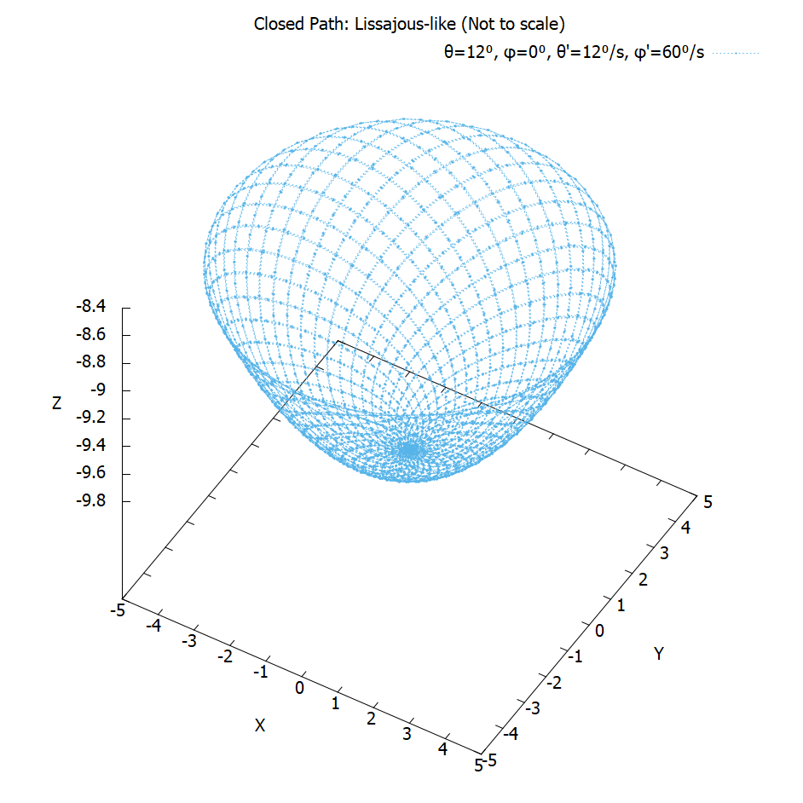
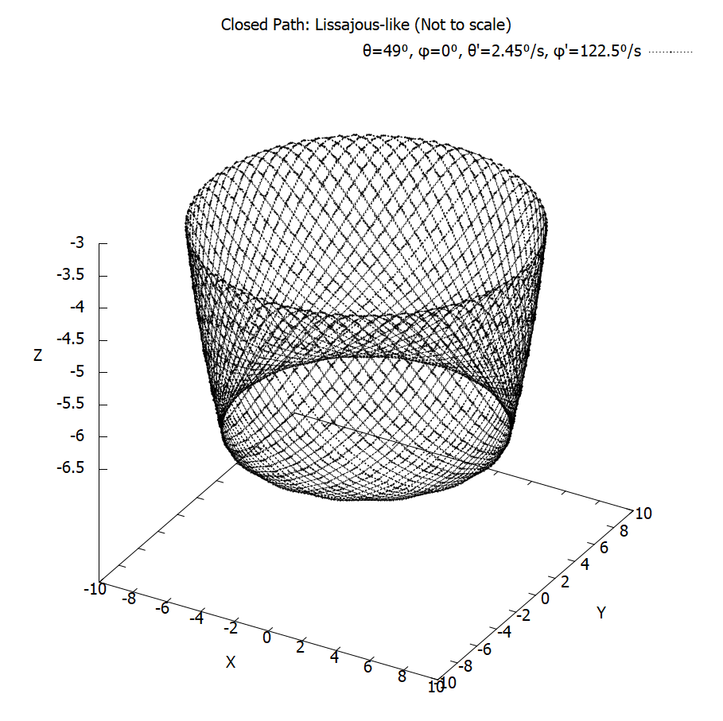
Closed paths
Some extra ones, in case you’re not yet satisfied.

Slide 37
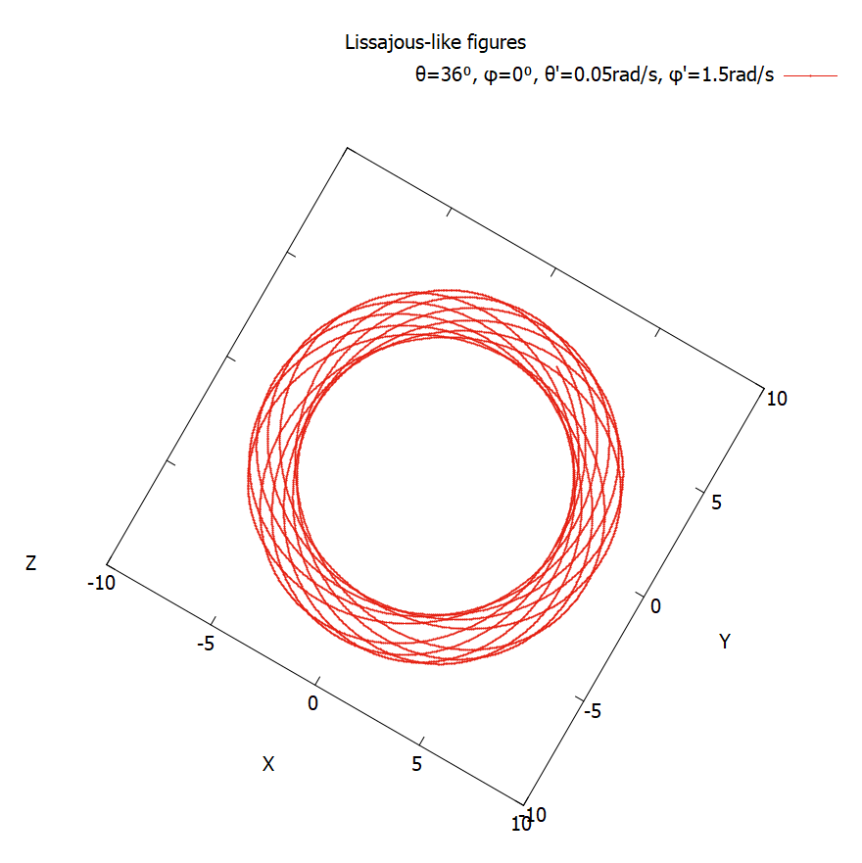
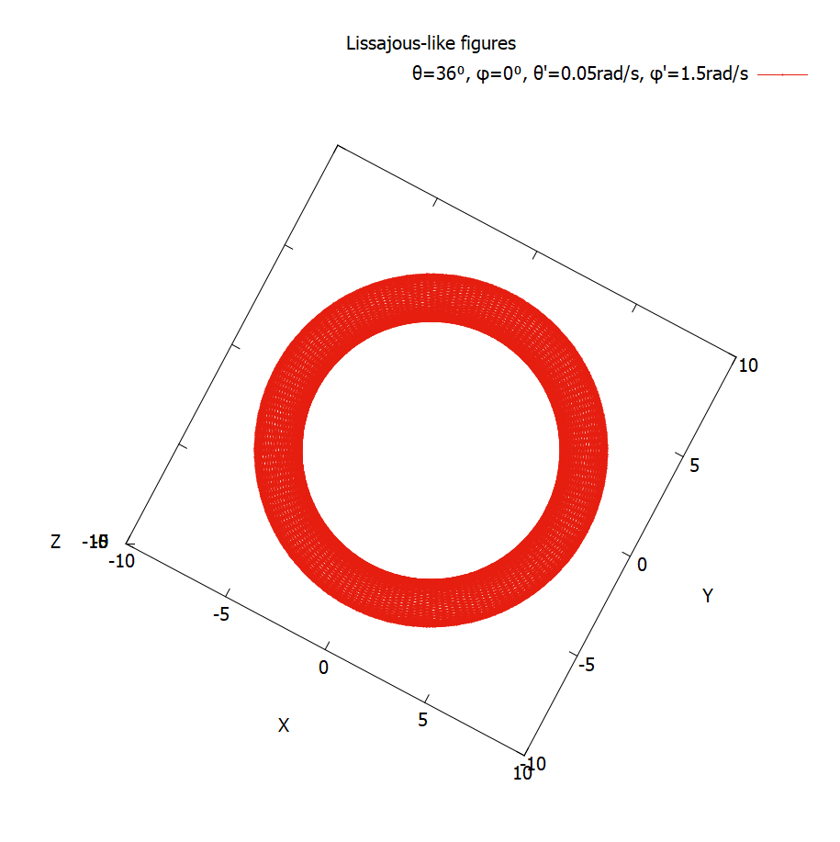
Lissajous-like figures
“Lissajous-like” figures aren’t always closed.

Slide 38
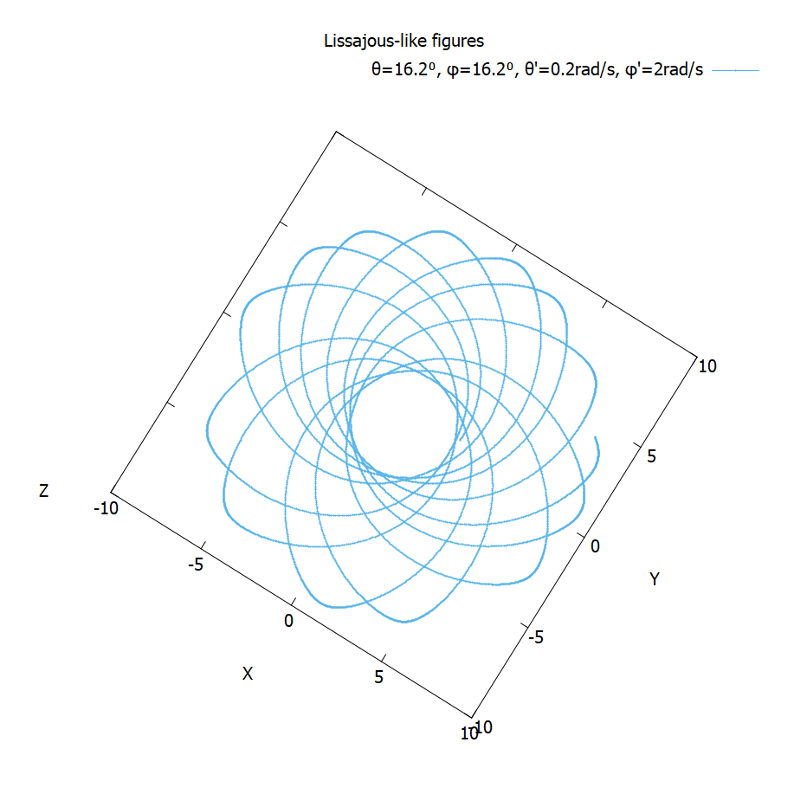
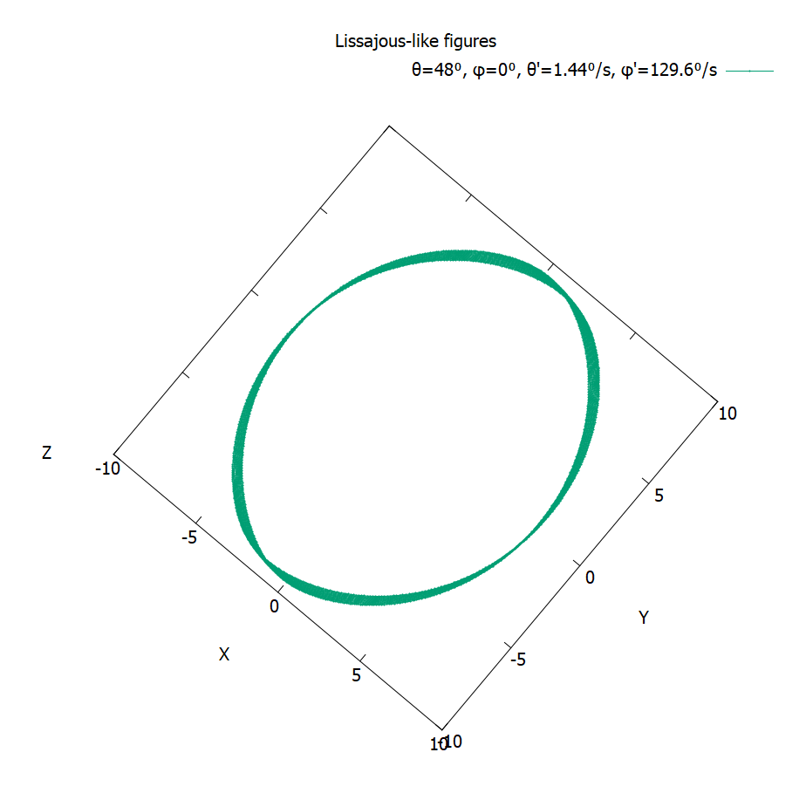
Lissajous-like figures
“Lissajous-like” figures are open to interpretations.

Slide 39
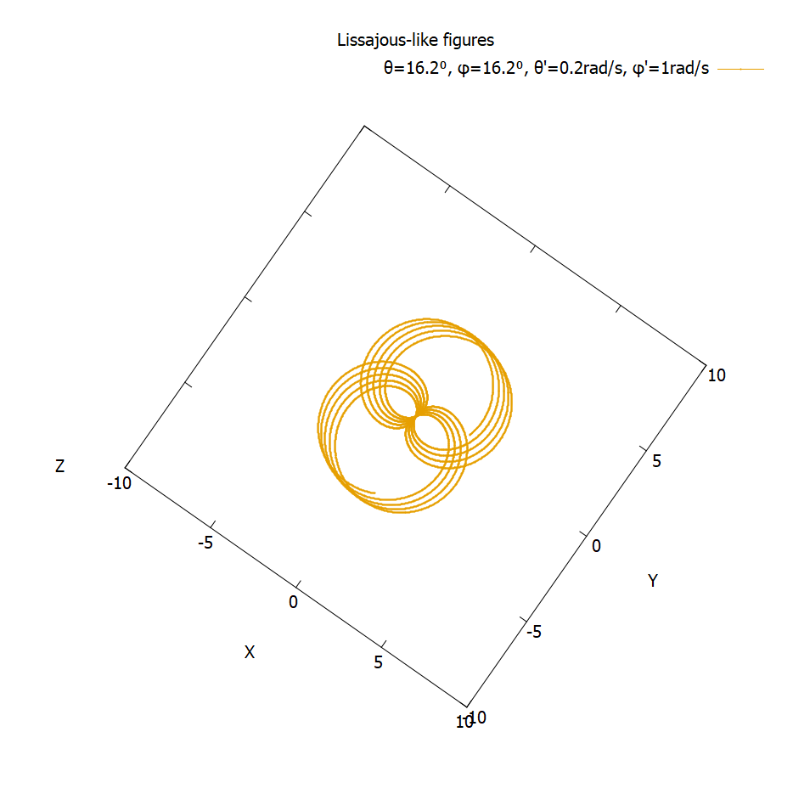
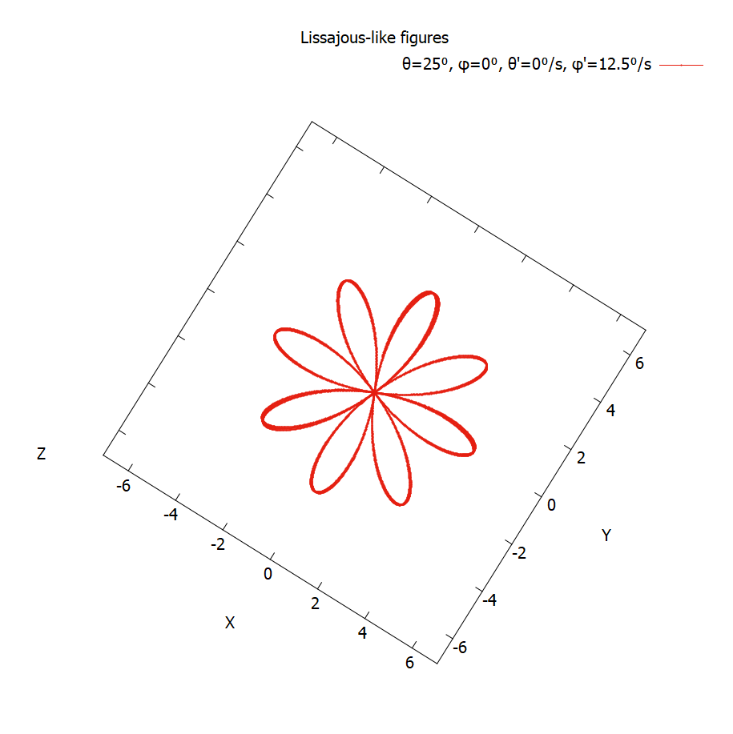
Lissajous-like figures
These are some of the figures we came up with.

Slide 40
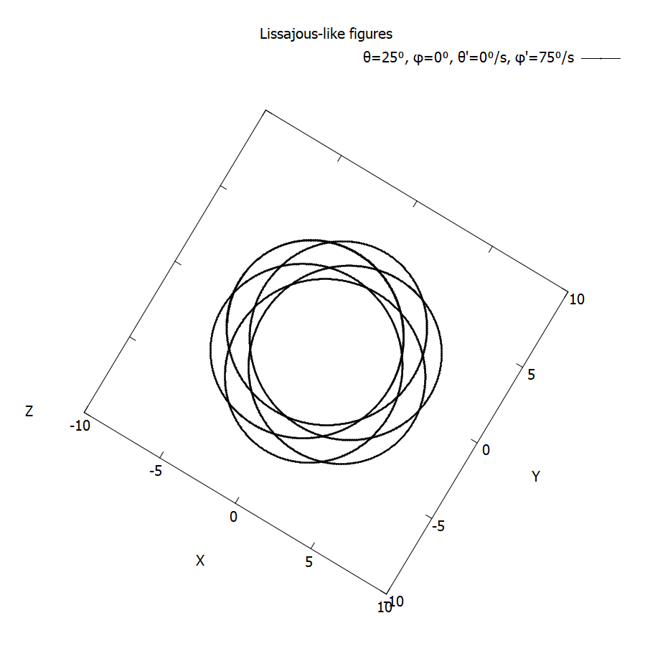
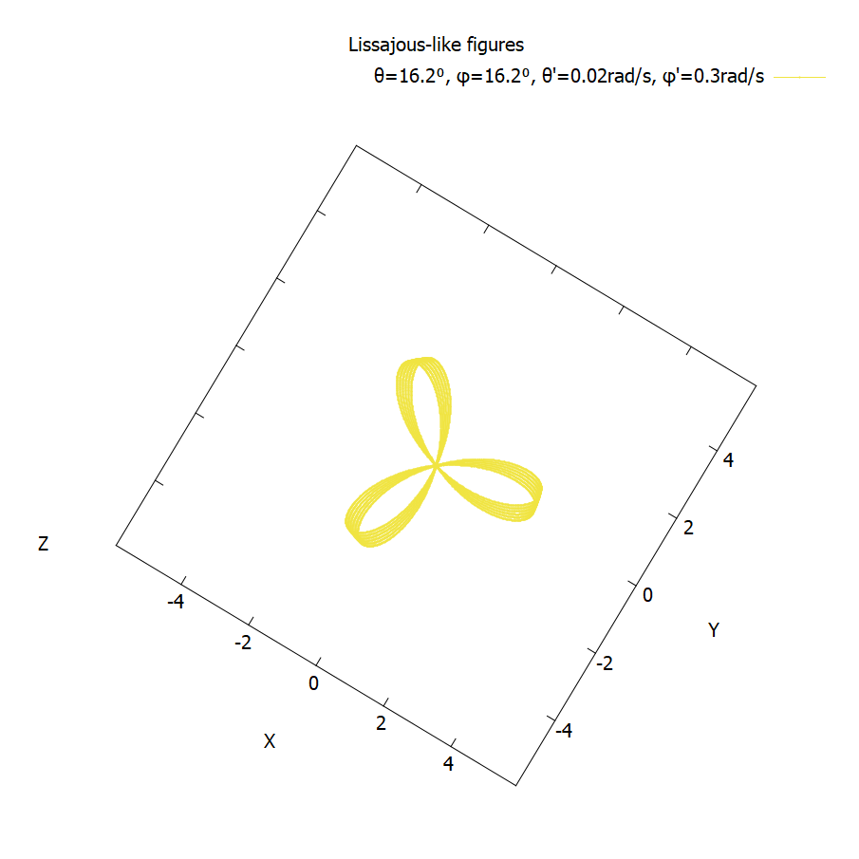
Lissajous-like figures
We can’t predict the shape from initial conditions.

Slide 41
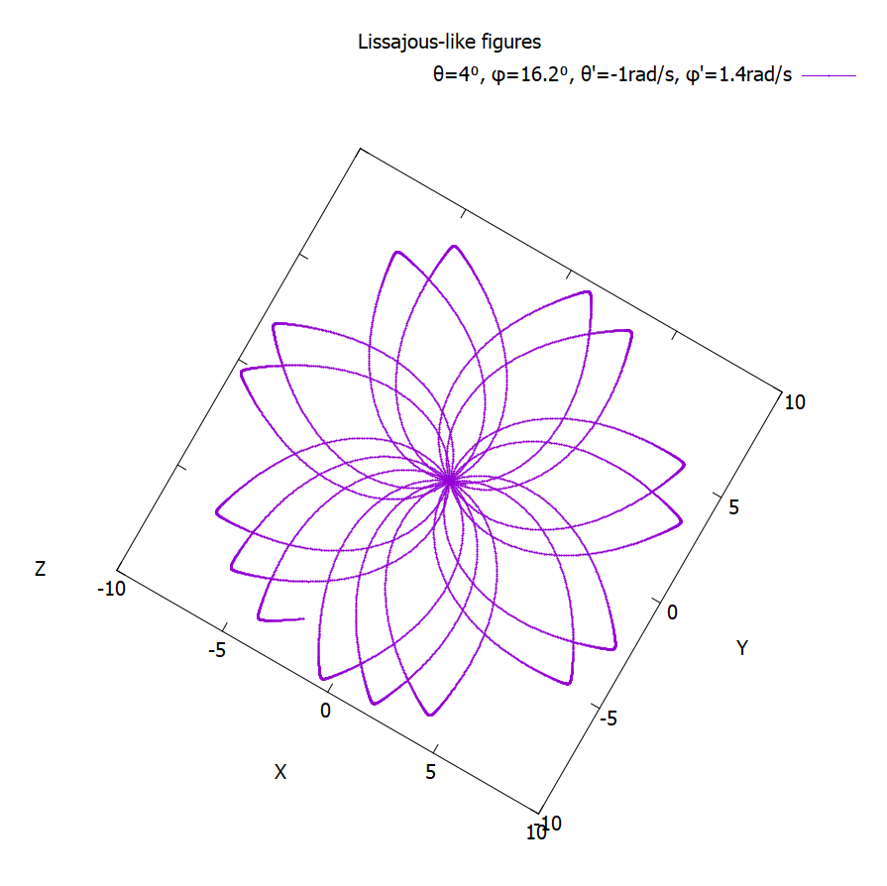
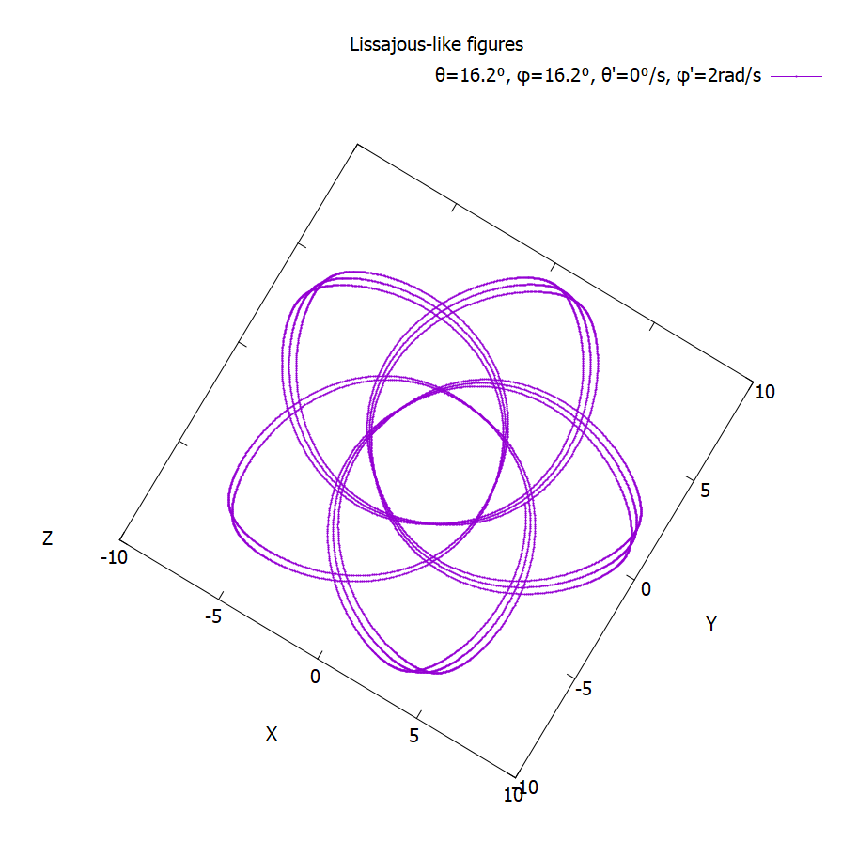
Lissajous-like figures
But they’re pretty nevertheless.

Slide 42
Lissajous-like figures
Here are some moving ones for your enjoyment.

Slide 43
Adding damping effect
Adding damping gave us the expected over/under-damped behaviors.

Slide 44
Damping coefficients
Adding damping effect
Mercury is the closest planet to the Sun and the smallest one in the Solar System—it’s only a bit larger than the Moon

Slide 45
Conservation of energy

Slide 46
Conservation of angular momentum

Slide 47
Optional part

Slide 48
Our philosophy
Mercury
Venus
Mercury is the closest planet to the Sun and the smallest one in the Solar System—it’s only a bit larger than the Moon
Venus has a beautiful name and is the second planet from the Sun. It’s hot and has a poisonous atmosphere

Slide 49

A picture is worth a thousand words

Slide 50

Market trends
25%
25%
25%
25%
Venus has a beautiful name
Mercury is the smallest planet
Jupiter is the biggest planet
Mars is a very cold place
Venus
Jupiter
Mercury
Mars
Follow the link in the graph to modify its data and then paste the new one here. For more info, click here
Notes:
El gráfico de tiene que estar hecho por Google Sheets. Hay que incluir una leyenda para que el usuario pueda incluir información de la gráfica

Slide 51
Thanks!
Do you have any questions?
addyouremail@freepik.com
+91 620 421 838
yourcompany.com
Please keep this slide for attribution

Slide 52
Resources
Did you like the resources on this template? Get them for free at our other websites.
Photos:
Front view of man doing a presentation during a meeting
Studio portrait of beautiful woman
Person working as part of company team
Front view of businessman with colorful cones representing growth
Vectors:
Flat design ui and ux elements
Icons:
Business icon pack

Slide 53
Fonts & colors used
This presentation has been made using the following fonts:
Raleway
(https://fonts.google.com/specimen/Raleway)
Barlow
(https://fonts.google.com/specimen/Barlow)
#363636
#ffffff
#fccf78
#f57dc6
#6aa1f7
#9d59db
#b3d5f2
#9ae6ae
#777777
#464646

Slide 54


